Slide 1
Identifying Performance Bottlenecks
Yoav Etsion

Slide 2
Outline
Bottleneck visualization methods
Flame graph
CPI stack
Common bottlenecks
Storage
Network
Memory (it’s always the memory)

Slide 3
Outline
Bottleneck visualization methods
Flame graph
CPI stack
Common bottlenecks
Storage
Network
Memory (it’s always the memory)

Slide 4
Flame Graphs
Effective method to visualize where applications spend their time
Tells us where the bottlenecks likely are, not what causes them
Developed by Brendan Gregg
https://www.brendangregg.com/flamegraphs.html
Many performance tools generate them
Typically, by passing the right text format to a flame graph library

Slide 5
Flame Graphs

Slide 6
Flame Graphs
Call stack
Application run time

Slide 7
Flame Graphs
Colors are random ☺
Call stack
Application run time

Slide 8
Flame graph: Example
int main() {
foo();
// do something
bar();
}
void foo(){
foo.0();
foo.1();
…
}
void bar(){
bar.0();
bar.1();
…
}

Slide 9
Flame graph: Example
Call stack
main()
Application run time

Slide 10
Flame graph: Example
Call stack
foo()
bar()
main()
Application run time

Slide 11
Flame graph: Example
Call stack
foo.0()
foo.1()
bar.0()
bar.1()
bar.2()
foo()
bar()
main()
Application run time

Slide 12
Flame graph: Example
Call stack
What does main() do here? (~30% of run time)
foo.0()
foo.1()
bar.0()
bar.1()
bar.2()
foo()
bar()
main()
Application run time

Slide 13
Flame graph: Example
Is foo() the most efficient implementation?
What about foo.1()?
Call stack
foo.0()
foo.1()
bar.0()
bar.1()
bar.2()
foo()
bar()
main()
Application run time

Slide 14
Flame Graphs
Call stack
Application run time

Slide 15
Flame Graphs
Call stack
Application run time

Slide 16
Flame Graphs
Call stack
Application run time

Slide 17
How do we get the data for Flame Graphs?
Lucky for us, modern instrumentation tools do it
E.g., perf, Intel vTune
Naïve approach: Save the call stack on each function call (high overhead)
Common approach: Sampling
Sample the PC and record the branch history
Modern processors have hardware that logs branch history for that purpose
Based on PC, branch history, and binary, reconstruct the call stack
Pay attention to sampling frequency and regularity!

Slide 18
Flame Graphs summary
Very intuitive visualization of program run time
Once we learn how to read it ☺
Points us to the where (code) but not why (cause)
For that we need to look at the code and examine other metrics
Look out for sampling frequency tuning knob
The first step in navigating performance analysis of programs

Slide 19
Outline
Bottleneck visualization methods
Flame graph
CPI stack
Common bottlenecks
Storage
Network
Memory (it’s always the memory)

Slide 20
CPI stacks
Attribute fraction of the CPI is caused by what pipeline stall type
Use performance counters to identify what part of the processor pipeline stalls
Points us to the why (cause) but not where (code)
Dr. Hanna’s talk described the hierarchical counter methodology, which is very similar to CPI stacks
Pavlovic et al. “On the Memory System Requirements of Future Scientific Applications: Four Case Studies” In IEEE Intl. Symp. on Workload Characterization (IISWC), Nov 2011.

Slide 21
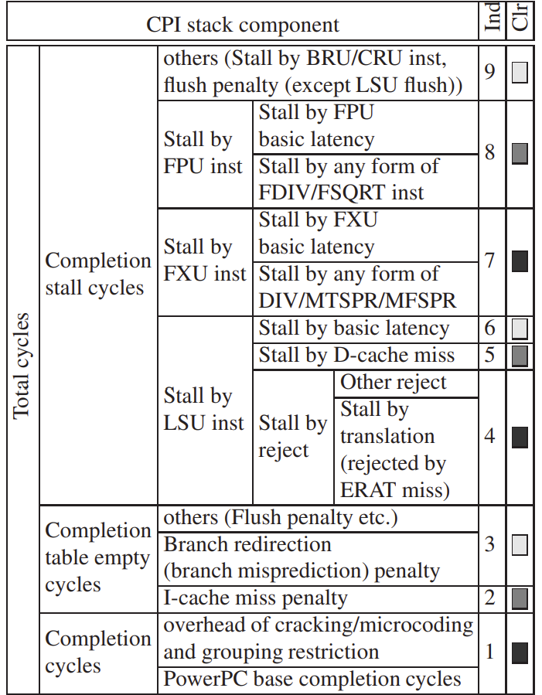
CPI stack: Methodology
Performance counters are architected to cover different pipeline stalls
Use:
Track counters over a period of time
Divide each counter value by total cycles
Example: IBM PowerPC 970

Slide 22
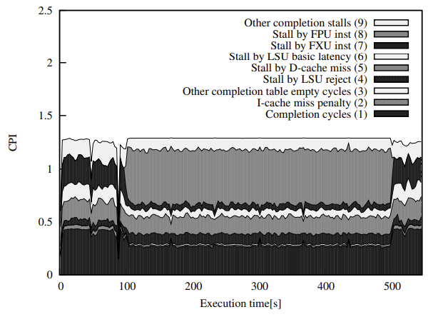
CPI stack example
32x IBM PowerPC 970
MareNostrum supercomputer
App: WRF (weather research and forecasting)
[Apologies for the B/W image…]

Slide 23
CPI stack example
32x IBM PowerPC 970
MareNostrum supercomputer
App: WRF (weather research and forecasting
[Apologies for the B/W image…]
Floating point stalls (not enough FPUs; no pipelining)

Slide 24
CPI stack example
32x IBM PowerPC 970
MareNostrum supercomputer
App: WRF (weather research and forecasting
[Apologies for the B/W image…]
Data cache misses

Slide 25
Sampling for CPI stacks
Decide on sampling periods
Short periods more accurate, but incur more overhead
5 seconds in WRF example
Problem: We cannot track all counters at the same time
Need to track different sets of counters
Interleave samples across time and space

Slide 26
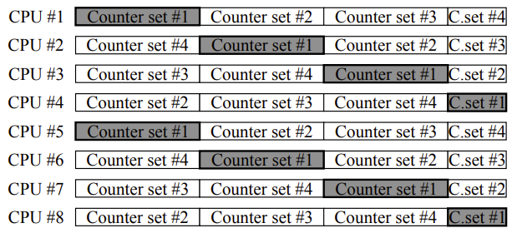
Sampling for CPI stacks
Each CPU: Iterate counter sets
Cross CPUs: Sample different sets
What is the limitation of this method?

Slide 27
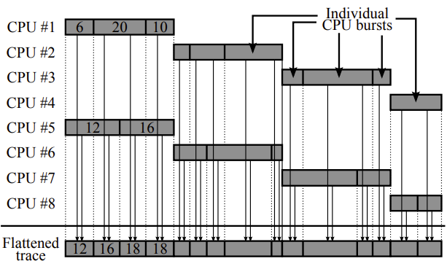
Sampling for CPI stacks
Need to merge samples
Challenge: Sampling periods are not in sync
Assume behavior is uniform inside sampled periods
Break down periods based on exact sampling time
Caveats:
Sampling period must be short enough
Workload must be homogeneous across cores

Slide 28
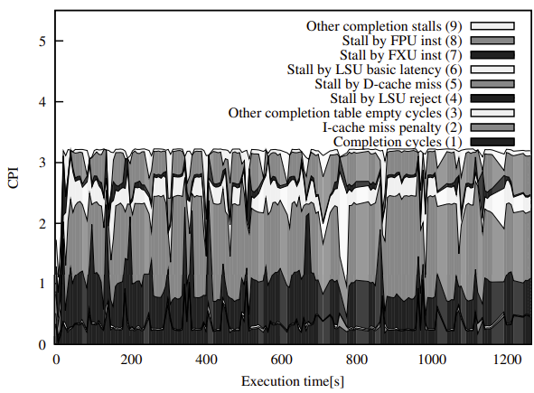
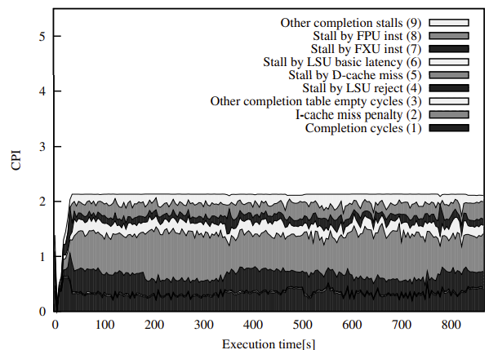
CPI stacks: More examples
MILC (particle physics simulation), 16 procs.
MILC, 32 procs.
Data cache misses
What happens when we move to 32 procs?

Slide 29
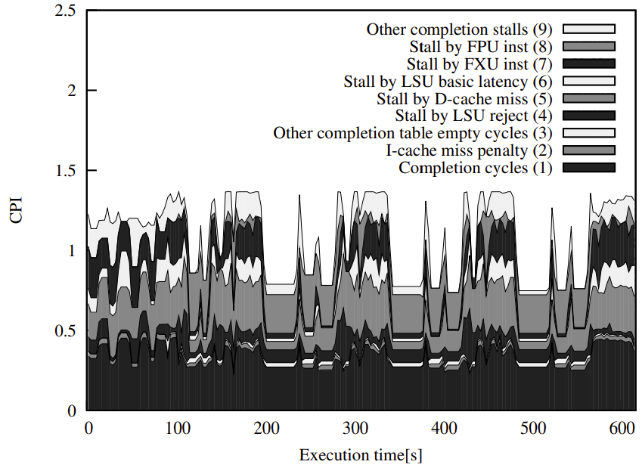
CPI stack: See the compute phases
GADGET, 32 procs.
(GAlaxies with Dark matter and Gas interact)

Slide 30
CPI stacks: Summary
Very detailed information of bottlenecks
Typically, we don’t need the full stack; only track specific counters
Doesn’t point us to the problematic code
Should be used in tandem with Flame Graphs (and other tools)
Requires architectural support for the right counters
Most architecture support it nowadays
An earlier name for hierarchical stall methodology Mr. Hanna described

Slide 31
Outline
Bottleneck visualization methods
Flame graph
CPI stack
Common bottlenecks
Storage
Network
Memory (it’s always the memory)

Slide 32
Storage
Storage (aka, disk), is a clear bottleneck
High latency
Low BW (compared to, e.g., memory)
The bottleneck is so clear that systems are built to hide it
Systems typically tackle this by restructuring software

Slide 33
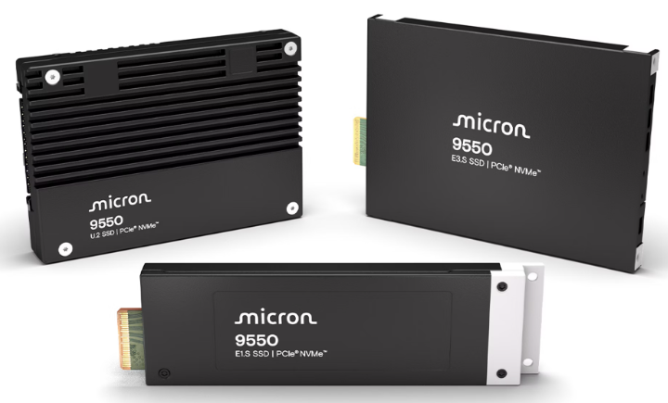
Storage
High-end SSD example: Micron 9550 SSD
Latency (typical):
Read: 60us (over 200x slower than DRAM)
Write: 10us
BW:
Read sequential: 14GB/s
Write sequential: 10GB/s
Read random: 11.2GB/s
Write random: 1.6GB/s

Slide 34
Storage: Latency hiding
Latency is the biggest problem; how to we hide it?
First thing to try: Cache data in memory
E.g., OS page cache
In-memory databases
Spread memory across multiple servers (e.g., Apache Spark for data analytics)
If that fails, use multiprocessing / multithreading
Latencies are so big that SW solutions are sufficient (latency >> context switch)
Concurrent accesses
Process one data item while requesting new data

Slide 35
Storage: Bandwidth
How do we deal with the limited storage bandwidth?
Data sharding: Partition data across multiple disks
E.g., split a database table across multiple disks/servers
Higher aggregate bandwidth, no storage waste
Data replication:
Wastes storage
Used when the same data accessed repeatedly, and caching can’t help
On the plus side, provides redundancy
E.g., RAID1+
E.g., GFS maintains 3 copies of each 64MB block
Sanjay Ghemawat, Howard Gobioff, and Shun-Tak Leung, The Google File System, In SOSP 2003

Slide 36
Storage: Trends
Moving storage to network offers multiple benefits
Disaggregated storage: Increasing storage capacity/BW does not affect server configuration
Dealing with data gravity: Compute can connect to data across the data center
NVMe
NVMe started over PCIe, overtook slower storage device protocols
-e.g., SAS, SATA, SCSI, iSCSI
NVMe-over-Fabric (NVMe-OF) lets servers use remote storage over network
SmartNICs take care of that

Slide 37
Outline
Bottleneck visualization methods
Flame graph
CPI stack
Common bottlenecks
Storage
Network
Memory (it’s always the memory)

Slide 38
Network
App
OS
NIC driver
int main()
{
uint8_t byte;
while(not finished) {
read(fd, &byte, 1);
process_byte(byte);
}
}
Request
Time
Response(s)

Slide 39
Network
Modern networks offer very high speeds and low latency
Bandwidth: 400gbs = 50GB/s
A DDR5 memory controller offers ~50GB/s
High-end servers have 8-16 controllers (but also several NICs)
Latency: 100s of nanoseconds between nodes in the same rack
Every switch on the way takes ~200ns
As networks are so fast, a key challenge is removing delays in the server
RDMA is getting more popular, but we won’t get to it

Slide 40

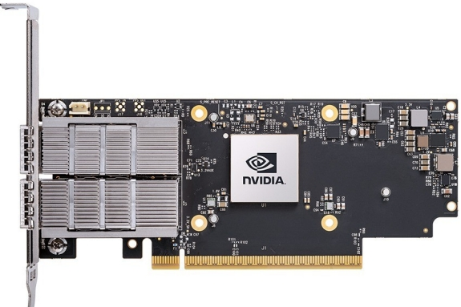
Network: How the system works
Receive buffer pool
Packet arrives from network
DDR5 50GB/s
IOMMU
PCIe gen5 64GB/s
PCIe root complex

Slide 41
Network: How the system works
Receive buffer pool
NIC writes to buffer pool using DMA (IP handling?)
DDR5 50GB/s
IOMMU
PCIe gen5 64GB/s
PCIe root complex

Slide 42
Network: How the system works
Receive buffer pool
DDR5 50GB/s
IOMMU maps to phys. address
IOMMU
PCIe gen5 64GB/s
PCIe root complex

Slide 43
Network: How the system works
OS support for zero-copy read
Receive buffer pool
DDR5 50GB/s
IOMMU
PCIe gen5 64GB/s
PCIe root complex

Slide 44
Network: What’s an IOMMU?
NICs (and GPUs; others) write to memory using DMA
We can’t let them write to any address
A big security flaw
IOMMU: maintains per-device page-tables for memory translation
TLB, page walkers, and everything
Challenge: need to maintain a very high-rate of translations
OS maintains per-device page-tables
OS vendors must make sure the IOMMU is configured correctly ☺
Markettos et al., “Thunderclap: Exploring Vulnerabilities in Operating System IOMMU Protection via DMA from Untrustworthy Peripherals”. NSDI 2019

Slide 45
Network: What’s an IOMMU?
NICs write sequential data (packets)
MMU structure of CPU might not be suitable for networking
IOTLB is too small
Device TLBs provide extended distributed translation caching, but can compromise security
Typical construct: a ring buffer
NIC fills them one after the other
OS updates the ring
Maybe the IOMMU should be redesigned for ring-buffers, not page-tables?
Malka et al., “rIOMMU: Efficient IOMMU for I/O devices that employ ring buffers”, In ASPLOS 2015

Slide 46
Network: Managing buffer pools
Buffers pools must be managed at network rate
Old buffers unmapped from IOMMU, new buffers added
Can reuse buffers, but data needs to be copied first
How should the OS be notified?
Interrupt handling is too slow
Modern systems use polling instead of interrupts to track packets
E.g., the DPDK framework (https://www.dpdk.org/)

Slide 47
Network: Zero-copy
Data copies are a constant performance pain
Consumes CPU time
Data copies consume precious memory bandwidth
DDRx is half-duplex
Data can be either read or written on a channel, not both at the same time
OS designers go to great length to minimize data copies
Goal is zero-copy: Avoid copying packets until the app/NIC reads them

Slide 48
Network summary (intermediate)
Increasing network speeds challenge conventional HW/SW co-design
Data goes through many stations adding latency
IOMMU is a performance challenge
Security comes at a cost
What are the right HW/SW constructs for fast and secure networking?
How can an IOMMU support sequential NIC writes and random-access GPUs?
Active research area; we barely scratched the surface
New bandwidth requirements for AI
AI requires remote load/store patterns; how can we provide that?
NVIDIA uses NVlink, a custom network just to connect its GPUs

Slide 49
Outline
Bottleneck visualization methods
Flame graph
CPI stack
Common bottlenecks
Storage
Network
Memory (it’s always the memory)
Well, almost always ☺

Slide 50
The memory hierarchy (reminder)
Goal: give the processor the view it has a memory with high capacity (dense), fast, consumes low power, and cheap
Solution: a Hierarchy of memories
Speed: Fastest Slowest
Size: Smallest Biggest
Cost: Highest Lowest
Power: Highest Lowest
CPU
L1
Cache
L2
Cache
L3
Cache
Memory
(DRAM)

Slide 51
The memory hierarchy (reminder)
Response time | Size | Memory level
≈ 0.5 ns | ≈ 100 bytes | CPU registers
≈ 1 ns | ≈ 32/64 KB | L1 cache
≈ 30 ns | ≈ 8 – 32 MB | Last Level cache (LLC)
≈ 100 ns (100s GB/s) | ≈ 10s GB | DRAM (HBM)
≈ 100 ns (10s GB/s) | ≈ 10s GBs to few TB | DRAM (DIMM)
W? r? 10s usecs | ≈ 100s GBs | SSD
≈ 5 ms | ≈Multiple TBs | Hard disk (SAS)

Slide 52
The memory hierarchy (reminder)
Temporal Locality (Locality in Time):
If an item is referenced, it will likely be referenced again soon
Example: code and variables in loops
⇒ Keep recently accessed data closer to the processor
Spatial Locality (Locality in Space):
If an item is referenced, nearby items are likely to be referenced soon
Example: scanning an array
⇒ Move contiguous blocks closer to the processor
Due to locality, memory hierarchy is a good idea
We’re going to use data we’ve recently used
And we’re going to use its immediate neighborhood

Slide 53
The memory hierarchy (reminder)
31
13
12
5
4
0
Tag
Set
Offset
Memory fetched in 64B blocks
Tag
Tag
Data
Data
Set#
Way 0
Way 1
=
=
MUX
Data Out
Hit/Miss

Slide 54
Memory hierarchy limitations
Rigid architecture tuned for sequential accesess and data locality
Data locality is crucial for performance
DRAM is ~100x slower than L1; ~10x slower than L2/LLC
Pointers-based structures are a pain for caching
Data must be partitioned to fit in the caches
Potential 10x-100x performance improvement

Slide 55
Don’t forget our view of computer systems
Problem
Computers are built to solve problems
But all solutions have constraints
Both the problem and constraints are moving targets and are co-dependent
Memory is where algorithms need to be tuned to hardware constraints
Algorithm
Software
Hardware/Arch.
VLSI flow
Devices
Physics

Slide 56
Compiler/Programmer Optimizations: Merging Arrays
// BEFORE: two arrays
int val[SIZE];
int key[SIZE];
// AFTER: Array of structs.
struct merge {
int val;
int key;
} merged_array[SIZE];
Merge 2 arrays into a single array of compound elements
Reduce conflicts between val and key
Improves spatial locality

Slide 57
Compiler/Programmer Optimizations: Loop fusion
Combine 2 independent loops whose data overlap
Assume each element in a is 4 bytes, 32KB cache, 32 B / line, array>$
for (i=0; i<10000; i++)
a[i] = 1 / a[i];
for (i=0; i<10000; i++)
sum = sum + a[i];
First loop: hit 7/8 of iterations
Second loop: array > cache ⇒ same hit rate as in 1st loop
Fuse the loops
for (i=0; i<10000; i++) {
a[i] = 1 / a[i];
sum = sum + a[i];
}
First line: hit 7/8 of iterations
Second line: hit all

Slide 58
Compiler/Programmer Optimizations: Loop interchange
Change loops nesting to access data in order stored in memory
Two-dimensional array in memory is row-major in C/C++/…
x[0][0] x[0][1] … x[0][99] x[1][0] x[1][1] …
Sequential accesses instead of striding through memory every 100 words
Improved spatial locality
/* Before */
for(j=0; j<100; j++)
for(i=0; i<5000; i++)
x[i][j]=2*x[i][j];
/* After */
for(i=0; i<5000; i++)
for(j=0; j<100; j++)
x[i][j]=2*x[i][j];

Slide 59
Matrix multiplication
Very common algorithm (AI anyone?)
Large matrices do not fit in the cache
E.g., a 10,000x10,000 matrix of SP FPs (32b) takes 400MBs
Multiplying large matrices using naïve algorithm traverses DRAM

Slide 60
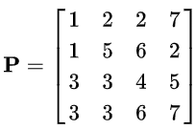
Matrix multiplication
Each dot product has no locality
If row/col do not fit in the cache, we get 2*N DRAM accesses
Total: N*N cache misses

Slide 61
Matrix multiplication
Each dot product has no locality
If row/col do not fit in the cache, we get 2*N DRAM accesses
Total: up to O(N³) cache misses

Slide 62
Blocked Matrix Multiplication Algorithm
A memory friendly algorithm that can tuned to fit (almost) any memory size
Complexity similar to naïve multiplication [ O(n³) ]
Based on simple operation reordering
Extensively used everywhere (esp. AI)

Slide 63
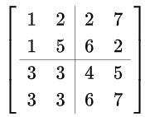
Blocked Matrix Multiplication Algorithm
Step 1: Partition the matrix into sub-matrices
Example: https://en.m.wikipedia.org/wiki/Block_matrix

Slide 64

Blocked Matrix Multiplication Algorithm
Let’s refer to each sub-matrix as A_{i,j}

Slide 65
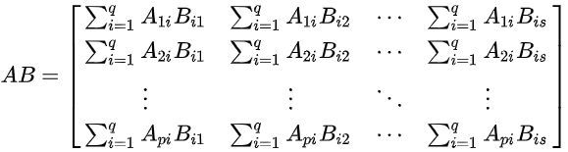
Blocked Matrix Multiplication Algorithm
A*B turns into multiplying and adding sub-matrices
Sub-matrix size is tuned to fit in the cache/fast memory

Slide 66
Blocked Matrix Multiplication Algorithm
Let’s tune sub-matrix dimension to N’= ¼ * cache size
Each sub-matrix multiplication takes O(N’)
Overlap compute and prefetch: Prefetch next two sub-matrices while multiplying current sub-matrices
If tuned correctly, we can hide all DRAM accesses
Result: N*N cache hits instead of O(N³) cache misses
Correct tuning can get us ~100x speedup

Slide 67
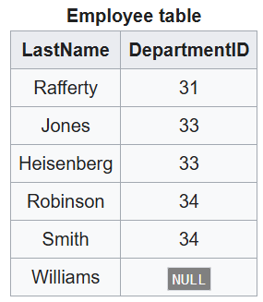
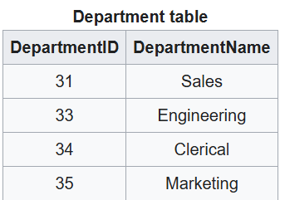
Another example: Multi-way JOINs The clash between theory and practice
JOIN is a basic database operator that connects matching rows
Most common algorithm: Hash JOIN
Example: https://en.wikipedia.org/wiki/Join_(SQL)

Slide 68
What’s a JOIN?
SELECT employee.LastName, employee.DepartmentID, department.DepartmentName FROM employee INNER JOIN department ON employee.DepartmentID = department.DepartmentID;

Slide 69
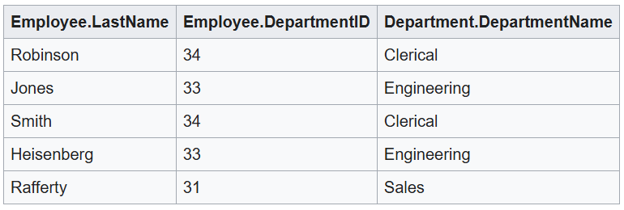
What’s a JOIN?
SELECT employee.LastName, employee.DepartmentID, department.DepartmentName FROM employee INNER JOIN department ON employee.DepartmentID = department.DepartmentID;

Slide 70
What’s a Multi-way JOIN?
Multiple JOIN operations applied to multiple tables
Common use: Graph algorithms
We store all connections (edges) in a table with two columns (src,dst)
A Multi-way JOIN can find paths or cycles

Slide 71
What’s a Multi-way JOIN?
Query: Find all nodes with distance 3 from node 3
aka “3-path” query
1
2
Src | Dst
1 | 5
2 | 1
2 | 4
3 | 2
4 | 5
3
R(3,x2) X R(x2,x3) X R(x3, x4)
4
5

Slide 72
What’s a Multi-way JOIN?
Query: Find all nodes with distance 3 from node 3
aka “3-path” query
Src | Dst
1 | 5
2 | 1
2 | 4
3 | 2
4 | 5
Src | Dst
1 | 5
2 | 1
2 | 4
3 | 2
4 | 5
Src | Dst
1 | 5
2 | 1
2 | 4
3 | 2
4 | 5

Slide 73
Multi-way JOIN: A new generation of algorithms
Traditional algorithms split multi-way joins into multiple pairwise joins
M. Yannakakis. Algorithms for acyclic database schemes. In VLDB, 1981
Downside: pairwise joins generate intermediate tables that consume memory
About 10 years ago a new class of algorithms came about
New theoretical bound: Worst-case Optimal
These algorithms handle any worst case better than traditional ones
One notable algorithm: Leap-frog Trie Join (LFTJ)
T. L. Veldhuizen. Triejoin: A simple, worst-case optimal join algorithm. In ICDT, 2014.

Slide 74
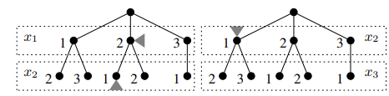
Multi-way JOIN: LFTJ
Use the Trie data structure
Each level in the Trie represents a column in the table
Levels/Columns are sorted
Finding a match is like backtracking through multiple Trie’s

Slide 75
Multi-way JOIN: LFTJ
Src | Dst
1 | 5
2 | 1
2 | 4
3 | 2
4 | 5
1 2 3 4
5 1 4 2 5

Slide 76

Multi-way JOIN: LFTJ
1 2 3 4
5 1 4 2 5
1 2 3 4
5 1 4 2 5
1 2 3 4
5 1 4 2 5

Slide 77
Multi-way JOIN: LFTJ
1 2 3 4
5 1 4 2 5
1 2 3 4
5 1 4 2 5
1 2 3 4
5 1 4 2 5

Slide 78
Multi-way JOIN: LFTJ
1 2 3 4
5 1 4 2 5
1 2 3 4
5 1 4 2 5
1 2 3 4
5 1 4 2 5

Slide 79
Multi-way JOIN: LFTJ
1 2 3 4
5 1 4 2 5
1 2 3 4
5 1 4 2 5
1 2 3 4
5 1 4 2 5

Slide 80
Multi-way JOIN: LFTJ
1 2 3 4
5 1 4 2 5
1 2 3 4
5 1 4 2 5
1 2 3 4
5 1 4 2 5

Slide 81
Multi-way JOIN: LFTJ
1 2 3 4
5 1 4 2 5
1 2 3 4
5 1 4 2 5
1 2 3 4
5 1 4 2 5

Slide 82
Multi-way JOIN: LFTJ
1 2 3 4
5 1 4 2 5
1 2 3 4
5 1 4 2 5
1 2 3 4
5 1 4 2 5

Slide 83
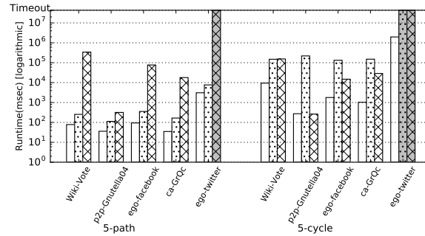
Multi-way JOIN: LFTJ’s performance
CTJ-C
LFTJ
YTD
(lower is better)
Kalinsky et al., “Flexible Caching in Trie Joins“. In EDBT 2017

Slide 84
Multi-way JOIN: LFTJ
What do you think might be problematic with LFTJ?
How can we overcome this problem?

Slide 85
Multi-way JOIN: LFTJ
Irregular memory accesses
A trie (tree) is a pointer-based structure
Many cache misses
Solution: Software caching of partial leap-frog scan results
Kalinsky et al., “Flexible Caching in Trie Joins“. In EDBT 2017

Slide 86
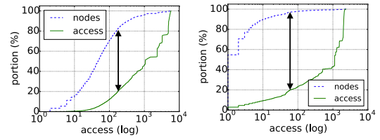
Multi-way JOIN: CTJ-C = LFTJ + caching
Why is caching partial results so effective?
5-path
5-cycle
Kalinsky et al., “Flexible Caching in Trie Joins“. In EDBT 2017

Slide 87
Summary
Call graphs and flame graphs are our first tool to find bottlenecks
Then, identify the cause:
Look at the code
Use performance counters
Common system bottlenecks have been there for ages, and it’s time to rethink their HW/SW primitives:
Storage: What primitives can help us reduce storage overhead?
Network: Can we rethink the way NICs move data to memory?
Can we eliminate IOMMU/buffer pool overheads?
Memory: Data accesses are biased; maybe a hash table interface is better?

Slide 88
Thank you Questions?

